Slide 1
NLP / DL DSCI 6004-03 / 6011-03
Project Proposal
Jainam Shah – 00790705
Sahil Sehgal – 00795874

Slide 2
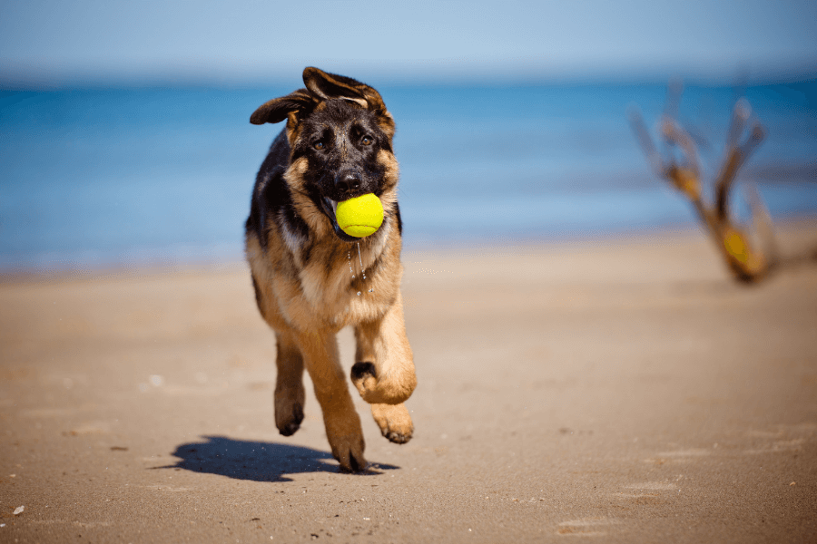
Image Captioning
Possible captions:
“dog playing on the beach”
“dog playing with ball in its mouth”
“dog running on the beach”
“dog running with a ball in its mouth on beach”
Fig. 1 Dog
Image Captioning is an application of Deep Learning for automatically generating text captions from an image.
Different ways to automatically generate image captions:
Partial Deep Learning
End-to-End Deep Learning

Slide 3
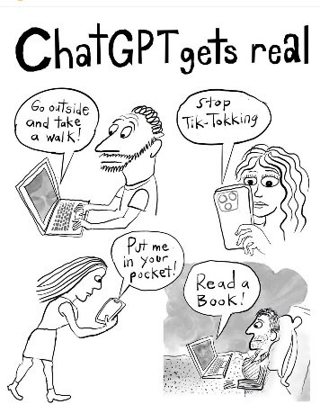
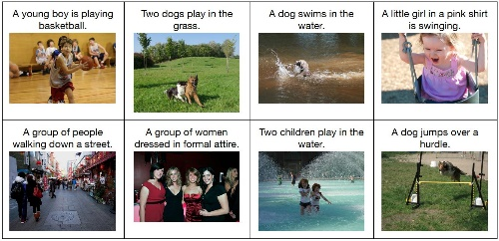
Project Objective
Transformers – Explore the capabilities of transformers for Image Captioning
Transformers gained popularity due to advancements in LLMs (Large Language Models) like ChatGPT (GPT – Generative Pretrained Transformer)
Capability of capturing long term dependencies in NLP related tasks such as text generation, machine translation, summarization, Q&A, etc.
Produce transformer-based architecture for Image Captioning
Deep Learning in Production – Build a deliverable AI application
Serving to consume deep learning model inference requests
Web application for users to upload image and generate caption
Fig. 4 ChatGPT
Fig. 5 Image Captions

Slide 4
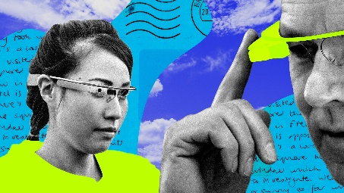

Statement of Value
An Assistive Technology
Further research on video captioning, object distance tracking, etc. can be done using similar approaches.
Can be combined with text-to-speech to implement an assistive bot for visually impaired people.
A creative social media tool
Such a tool can be used for automatically generating captions for social media posts.
Can be integrated with social media platforms like Instagram, Facebook, Twitter, etc.
Fig. 6 Smart Glasses
Fig. 7 Social Media

Slide 5
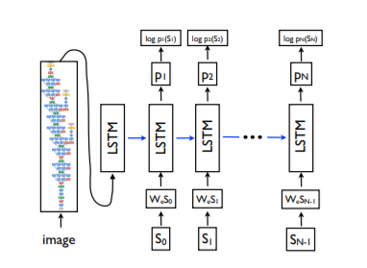
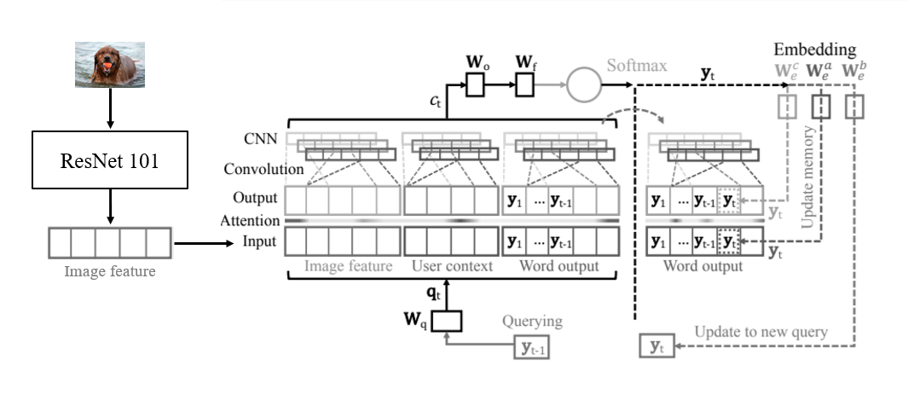
State of the Art / Relevant Work
Pioneering research in the field of Image Captioning.
Uses a pre-trained CNN as encoder, and LSTM as decoder to generate captions.
Fig. 8 Show & Tell [Src]
Image Captioning from Social Media perspective.
Context Sequence Memory Network that does not utilize any RNN / LSTM cells, however operates in sequential manner.
Fig. 9 CSMN [Src]

Slide 6
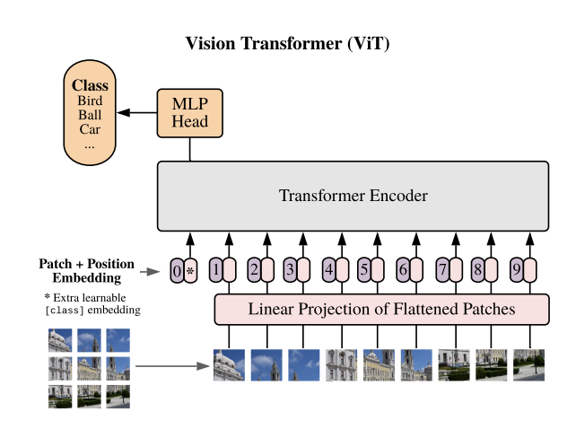
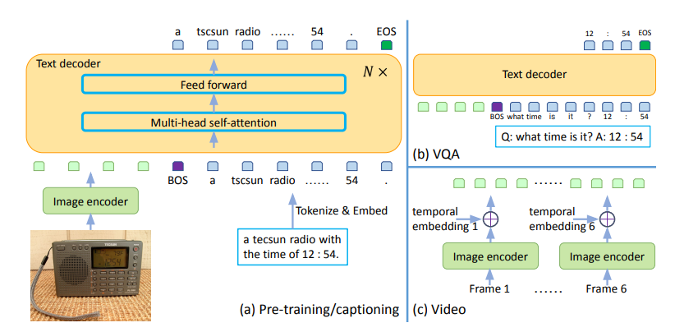
State of the Art / Relevant Work
Transformers for Image Classification
Divides image into patches and utilizes the encoder part of transformer.
Fig. 10 VIT - Vision Transformers [Src]
Transformers for Generative Image and Text applications.
Can do Image Captioning, Video Captioning, and Question Answering.
Fig. 11 GiT – Generative Image to Text Transformer [Src]

Slide 7

Proposed Architecture
Current SOTA for image classification (on ImageNet), and image captioning (on flicker30k) involves Vision Transformers (ViT).
We still believe CNNs to have better representational power compared to Transformers for Images.
We propose a semi transformer architecture where we utilize a SOTA CNN for image encodings, and transformer decoder for caption generation.
Dataset Details:
Name - Flicker30k
Size – 31,783
Source - https://datasets.activeloop.ai/docs/ml/datasets/flickr30k-dataset/
…
Generated Caption
Encodings
EfficientNetB4
Transformer Decoder
…
Image
Ground Truth Caption
Fig. 12 Proposed Architecture

Slide 8
Deliverable
Code
DL Model Architecture coded in Tensorflow framework
Model training and evaluation code
Web Application Server coded using Flask framework
DL Model
Trained DL Model in Tensorflow Saved Model format
Draft Paper
A draft research paper in CVPR / IEEE format (if time permits)

Slide 9
Evaluation
BLEU - Bilingual Evaluation Understudy
To assess the performance of our model, we will use BLEU score and compare with existing approaches.
Try different variants of BLEU: BLEU – 1, BLEU – 2, BLEU – 3, etc.

